Slide 1



Electrical Engineering Department
JECRC , Jaipur
TESLA 9/17
TESLA 9/17
September
2017

Slide 2

TESLA 9/17
What’s
Inside....??
1. Director’s message
2. Principal’s message
3. HOD’s message
4. Vision, Mission of Institute
5. Vision, Mission of Department
6. Program Outcomes
7. Placement Drives
8. Quiz Competition
9. Industrial Visit
10. Clean Surrounding Day
11. Engineer’s Day Celebration
12. Guest Lecturer Session
13. Achievements
14. Editorial Board

Slide 3

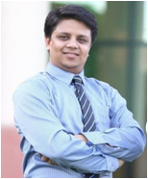

TESLA 9/17
Director JECRC, Jaipur
Message
The JECRC Foundation has been established with a view to provide world class education to our young minds so that they can shoulder their global responsibilities in the years to come.
The JECRC Foundation, now 18 years old, has established itself as one of the leading self-financed colleges in Northen India. This has been primarily due to the large significance that the college puts on the teaching learning process.
The focused areas at JECRC now, apart from teaching learning and placement would be research and development, entrepreneurship and outreach. We also strive to help our students in maintaining and spreading the rich Indian culture and lead the world as our country has done in the past. As you move ahead and rise higher in your life, you must entrench yourself in this unique realm that our culture endows us.
I wish to convey my greetings to all our Alumni and wish each one of them all success in their personal and professional lives.
Best Wishes
Mr. Arpit Agrawal
Director
JECRC, Jaipur

Slide 4
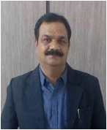
TESLA 9/17
Principal JECRC, Jaipur
Message
A desire can change nothing, a destination can change something but a determination can change everything. Life is a set of problems, an engineer has to solve the problems in their domain areas with strong innovative ideas and scientific knowledge. Your commitment to become an engineer by denoting your journey in Jaipur Engineering College and Research Center will be fruitful and enjoyable in every aspect, the experience you gain from here and the moments you spend here.
Best Wishes
Dr. V. K. Chandna
Principal
JECRC, Jaipur

Slide 5
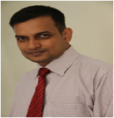
TESLA 9/17
HOD (EE)
JECRC, Jaipur
Message
Nikola Tesla, the well known Serbian- American electrical engineer is quoted as saying "Electrical sources has revealed to us the true nature of light has provided us with innumerate appliances and instruments of precision and has thereby vastly added to the exactness of our knowledge". His words portray the immensely wide and dynamically changing and ever developing world of electrical engineering open to electrical engineer.
It is a great pleasure to see the September, 2017 issue of EE newsletter “Tesla 09/17”. The department has well qualified staff with expertise in Power Systems, Control Systems, Power Electronics and Drives, Electrical Machines and Renewable Energy System assisted by skilled supporting staff. I would like to thank my existing team for their commitment and hard work. The department seeks to combine excellence in education and research. The core values of the department help the students to develop the students their overall personality and made them worthy technocrat to compete and work at global level. Our department has been conducting hands on workshop/seminar/training program since its beginning to keep the faculty and students to enhance the knowledge in their domain.Our mission includes a commitment to prepare students for professional and research activities with an ability to learn independently. I wish you all a successful, long-lived, engineering-based career path.
Best Wishes
Dr. Sandeep Vyas
HOD, Electrical Engineering
JECRC, Jaipur

Slide 6

Vision of the Institute
TESLA 9/17
To become a renowned centre of outcome based learning, work towards academic, professional, cultural and social enrichment of lives and communities .
Mission of the Institute
Focus on evaluation of learning outcomes and motivate student to inculcate research aptitude by project based learning.
Identify, based on informed perception of Indian, regional and global needs, the areas of focus and provide platform to gain knowledge and solution.
Offer opportunities for interaction between academia and industry.
Develop human potential to its fullest extent so that intellectually capable and imaginatively gifted leaders may emerge in the range of profession.

Slide 7
Vision of Department
TESLA 9/17
To Emerge as a Centre of Excellence in teaching in the area of Electrical Engineering; to serve as a valuable resource for society by promoting excellence.
Mission of Department
M1: To provide professional and ethical guidance to the students to make them employable .
M2: To improve quality of education through different quality development programs for faculty and students .
M3: To encourage students to acquire practical knowledge through projects and participation in national and international events .
M4: To prepare our students for upcoming challenges of life through guidance for competitive examinations .
4

Slide 8
TELSA
9/17
PROGRAM OUTCOMES
Engineering knowledge: Apply the knowledge of mathematics, science, engineering fundamentals, and an engineering specialization to the solution of complex engineering problems.
Problem analysis: Identify, formulate, research literature, and analyze complex engineering problems reaching substantiated conclusions using first principles of mathematics, natural sciences, and engineering sciences.
Design/development of solutions: Design solutions for complex
Engineering problems and processes that meet the
design system components or specified needs with appropriate
consideration for the public health and safety and the cultural, social, and environmental considerations.
Conduct investigations of complex problems: Use research-based knowledge and research methods including design of experiments, analysis and interpretation of data, and synthesis of the information to provide valid conclusions.
Modern tool usage: Create, select, and apply appropriate techniques, resources, and modern engineering and IT tools including prediction and modelling to complex engineering activities with an understanding of the limitations.
The engineer and society: Apply reasoning informed by the contextual knowledge to assess societal, health, safety, legal and cultural issues and the consequent responsibilities relevant to the professional engineering practice.
4

Slide 9
TESLA 9/17
Environment and sustainability: Understand the impact of the professional engineering solutions in societal and environmental contexts and demonstrate the knowledge of and need for sustainable development.
Ethics: Apply ethical principles and commit to professional ethics, responsibilities and norms of the engineering practice.
Individual and team work: Function effectively as an individual and as a member or leader in diverse teams, and in multidisciplinary settings.
Communication: Communicate effectively on complex engineering activities with the engineering community and with society at large, such as, being able to comprehend and write effective reports and design documentation, make effective presentations and give and receive clear instructions.
Project management and finance: Demonstrate knowledge and understanding of the engineering and management principles and apply these to one’s own work, as a member and leader in a team, to manage projects and in multidisciplinary environments.
Life-long learning: Recognize the need for, and have the preparation and ability to engage in independent and life-long learning in the broadest context of technological change.
4

Slide 10
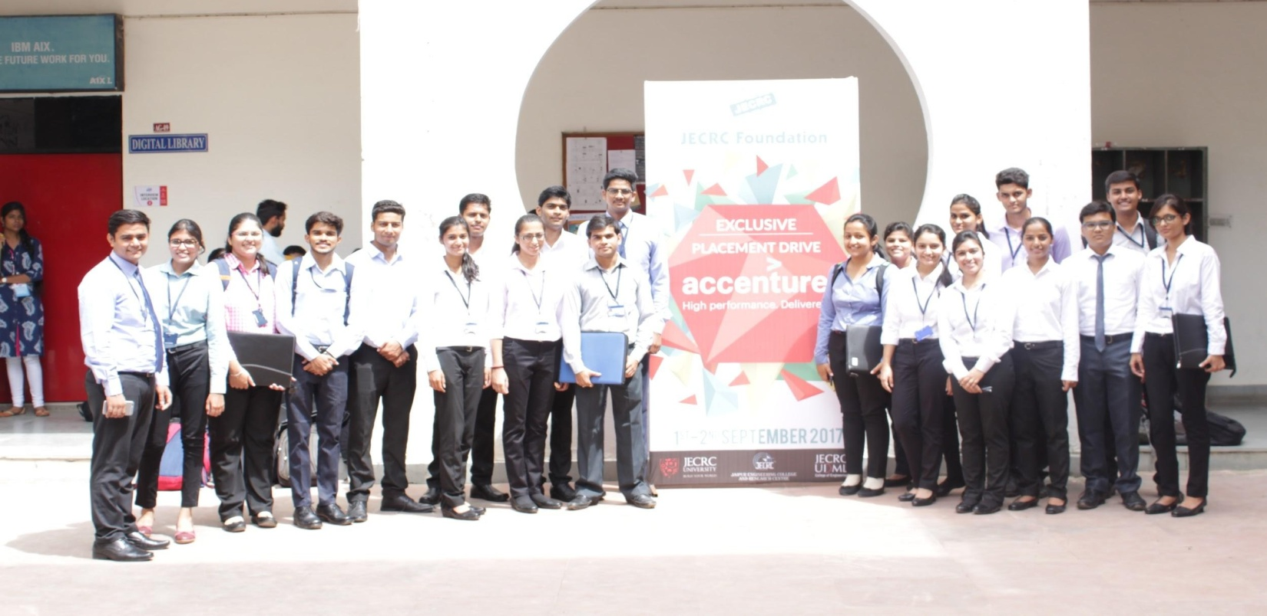
TESLA 9/17
PLACEMENT DRIVES
Accenture-Placement Drive
The IT giant Accenture came for the campus placement on 1-2nd Sep and they conducted a lot of activities for the selection process of students which included aptitude test at first and then it was followed by GD and personal interview . And 71 students were selected from the college and 5 of them were from EE department.
Pinnacle -Placement Drive
On 11-12th Sep second placement drive was organized by the Pinnacle-InfoTech-the global leader in BIM & CAD services. Being the leader provides of innovative BIM services to the architecture, engineering & construction industry for 18 years , Pinnacle has selected 11 students of Electrical department through a rigorous selection.
Artech- Placement Drive
On 11th Sep outset placement drive was organized by the Artech Which included aptitude test then it was followed by GD and personal Interview. Only one student was selected from the college.
6

Slide 11
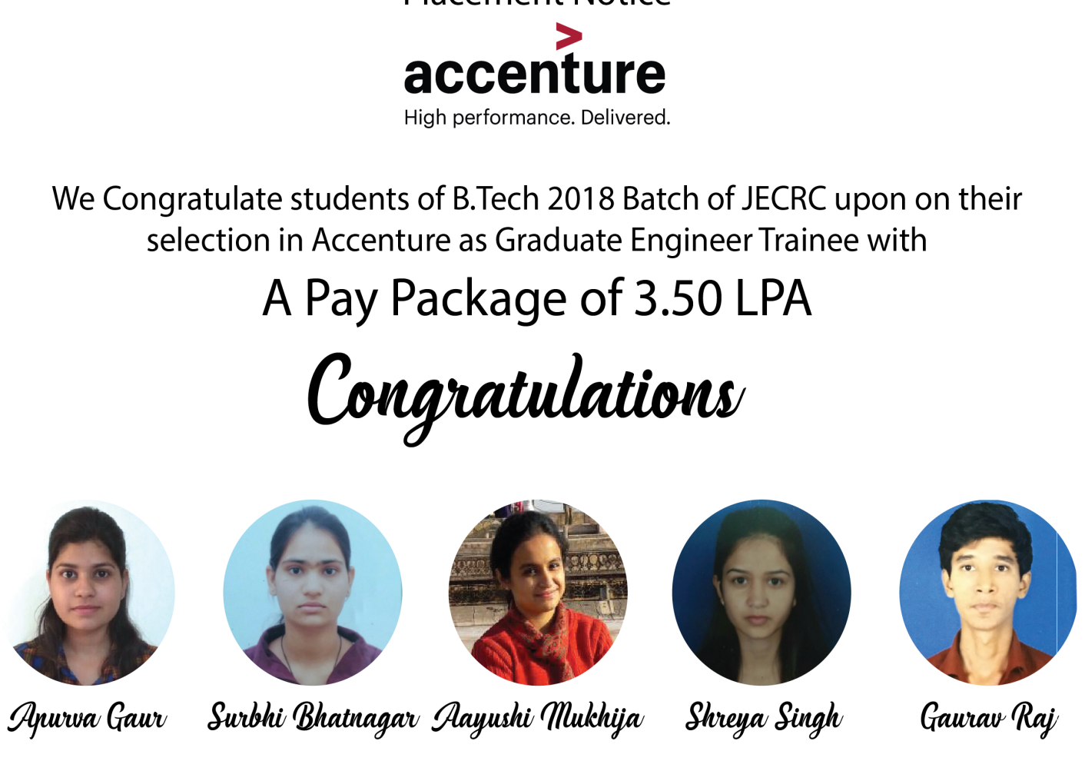
TELSA 9/17
PLACED STUDENTS

Slide 12
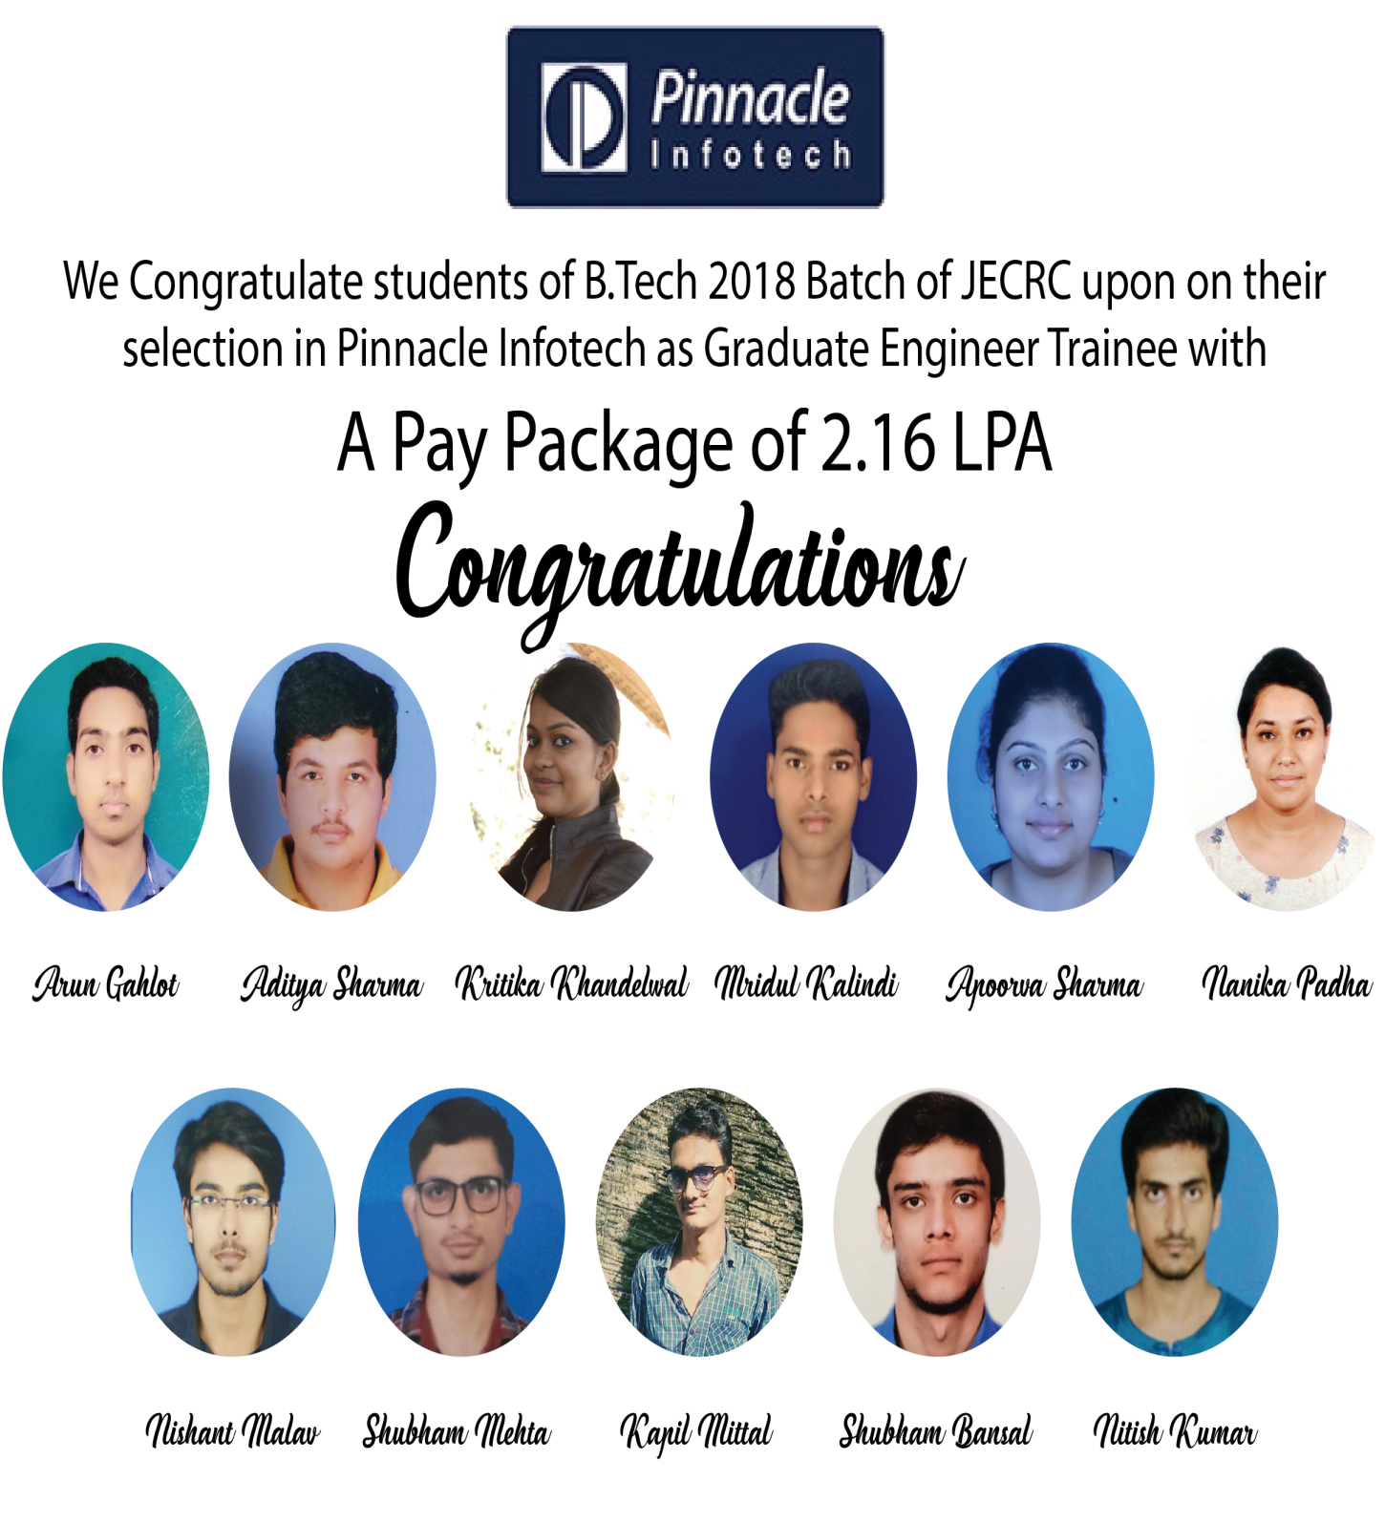
TELSA 9/17

Slide 13
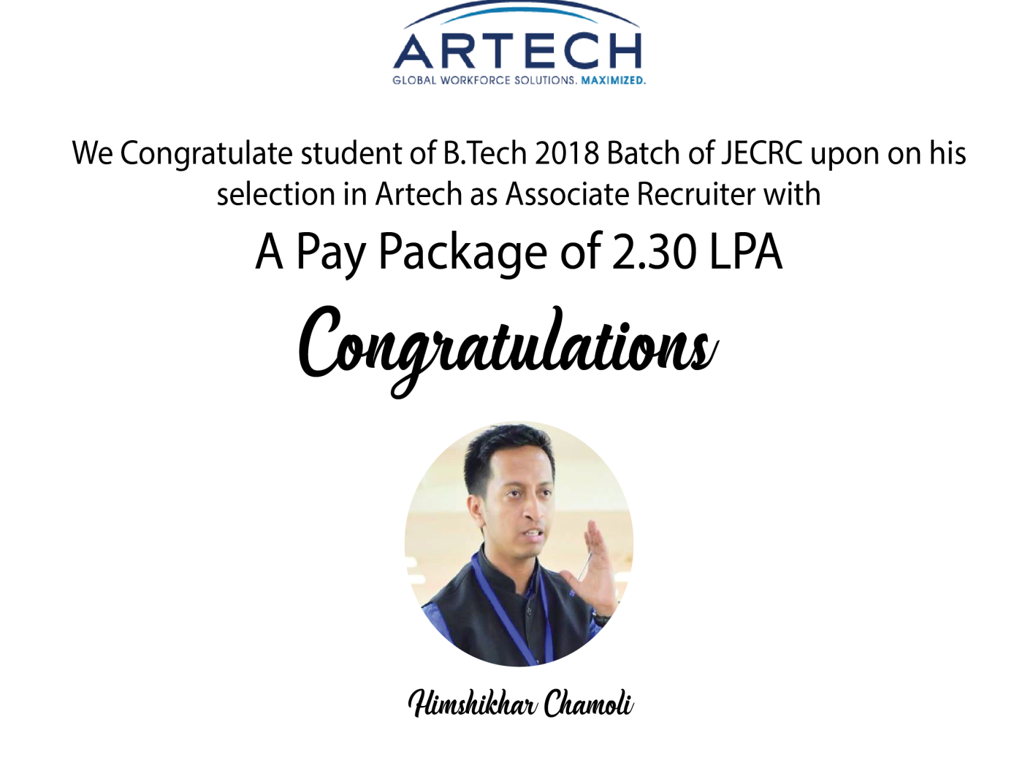
TELSA
9/17

Slide 14
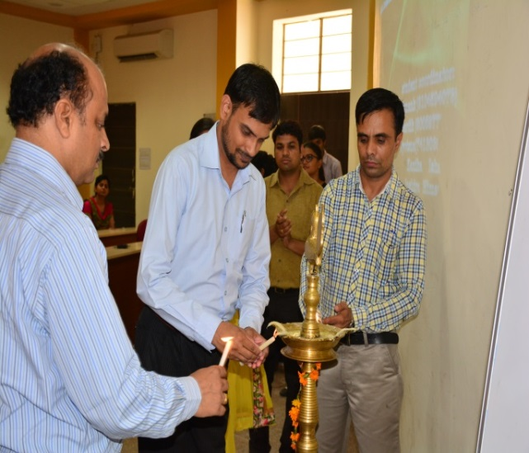
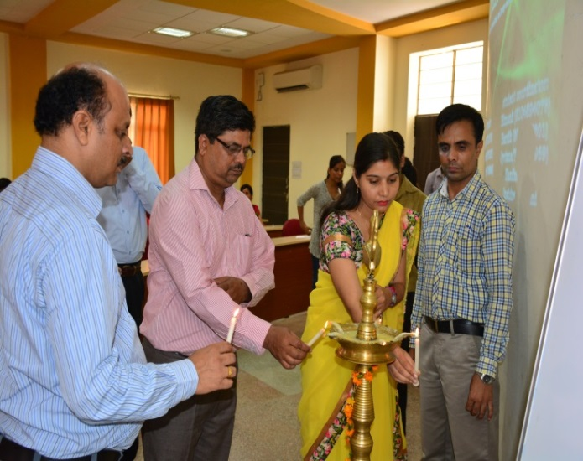
TELSA
9/17
QUIZ COMPETITION
The college level competition of ENERGY BUZZ –an energy quiz competition was held on 05/09/2016 on the occasion birth day of our former President of India. His Excellency Dr. Sarvepalli Radhakrishnan at CS-01 C-Block JECRC Jaipur. The Inaugural meeting commenced at 12.45 pm. Teacher coordinators: The meeting was presided over by Dr. Sandeep Vyas, Head of Department Electrical, Inaugurated the meeting by lighting the lamp and delivered the inaugural address. During his talk, he shared his own experience with the students and faculty members. Mr. Gopal Tiwari delivered the vote of thanks. 24 teams from 3rd and 5th Semester of Electrical Engineering Department participated in the competition.
Teacher Coordinators
1. Mr.ram Singh, Assistant Professor
2. Mr. Gopal Tiwari, Assistant Professor
3. Mrs. Ravita Saraswat, Assistant Professor

Slide 15
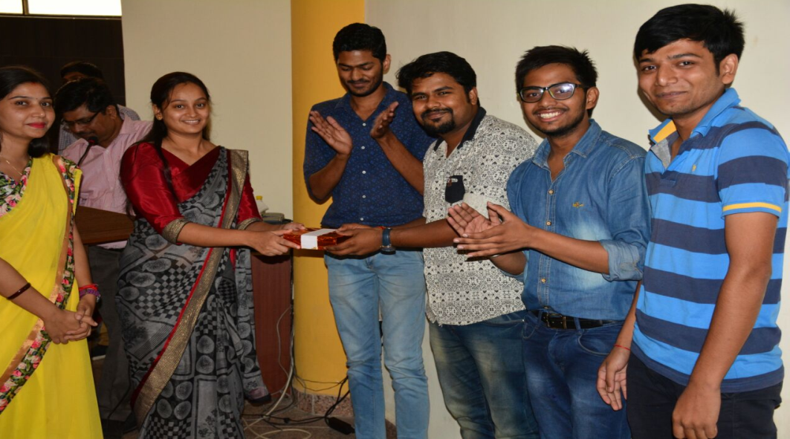
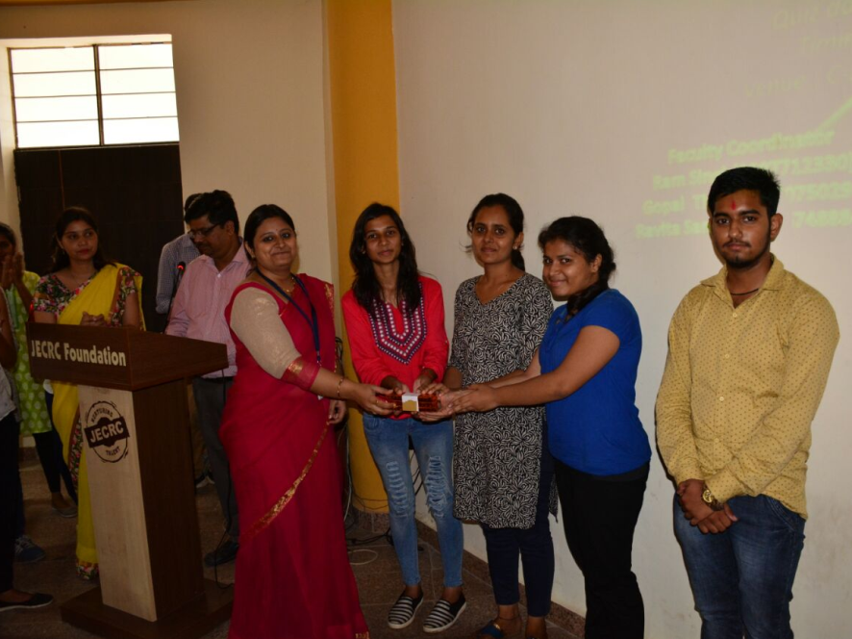
TESLA 9/17
WINNERS
First prize:
Mr. Prakhar Joshi, Mr. Shakti Pratap Singh,
Mr.Saksham Garg, Mr. Tarun Garg
Second prize:
Ms. Sonia Bansal, Ms. Somya Paliwal
Ms. Shaiphali Jain, Mr. Aditya Soni

Slide 16
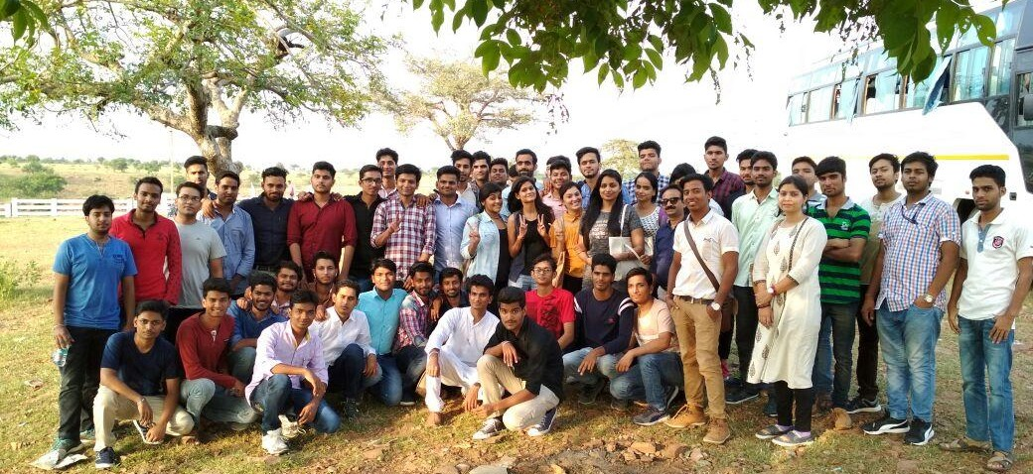

TESLA 9/17
INDUSTRIAL VISIT
As per Rajasthan Technical University(RTU) curriculum, the Jaipur Engineering College and Research Centre, Jaipur have to arrange an industrial visit for B.tech 3rd Year E.E students. So, on 6th Sep’17 an industrial visit to Kota Super Thermal Power Station was managed for 53 students of Electrical Engineering 3rd year Section A&B under the coordination of Assistant Professor Mr.Shailendra Shrivastava, Mr. Rahul K. Malee, Ms Ravita Saraswat.
Assistant Engineer (Training), Mr S.K. Madan of Kota Super Thermal Power Station was demonstrated the different areas inside the plant.
Philosophy
. 8

Slide 17
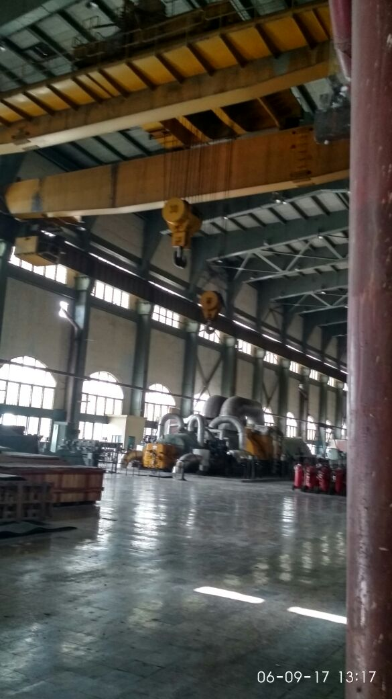
TESLA 9/17
At KSTPS, the students learnt about the power generation process and new technologies. They collected information on the social aspects of the project, viz capacity of KSTPS, units of power generated, its supply and distribution. The students learned about the management of Thermal power generation under varying availability of coal and varying demand. During the Kota Super Thermal Power station visit, students also visited the Geparnath Mahadev Temple and Hanging Bridge. We are return back to the Jaipur Engineering College and Research Centre, Jaipur at 11.55 PM. The students give the thanks to head of department and staff members of electrical engineering for organizing such a pleasant industrial visit.

Slide 18
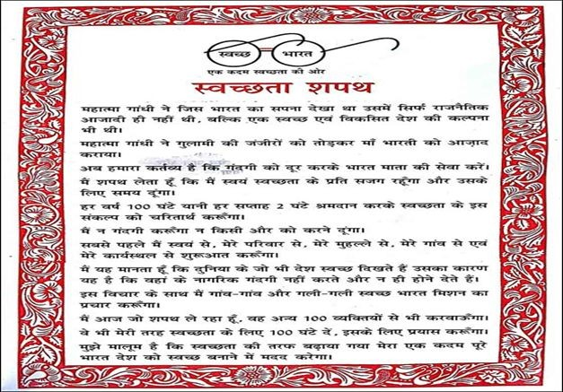
TESLA 9/17
CLEAN SURROUNDING DAY
SWAKCHTA PAKHWADA activities organized by JECRC according to AICTE from 1/9/2017 to 15/09/2017 and Electrical Engineering Department have completed CLEAN SURROUNDING activity on 06/09/2017.
The objective of the Event is to spread the awareness among people that cleanliness is next to Godliness.
According to schedule, faculty coordinator, student coordinator, other student of Electrical engineering department and other department student gathered at front gate of B-block at 11:30Am. Dr. Sandeep Vyas (HOD, EE) addressed all students about SWAKCHTA PAKHWADA and gave a message “All of us live in a neighborhood or surrounding. We must keep our surroundings neat and clean. This will help us to live healthy and better lives. Keeping our surroundings clean will only help in the betterment of society”.
After the message of DR. Sandeep Vyas, EE department faculties and after
109 students have taken
the oath of cleanness-

Slide 19
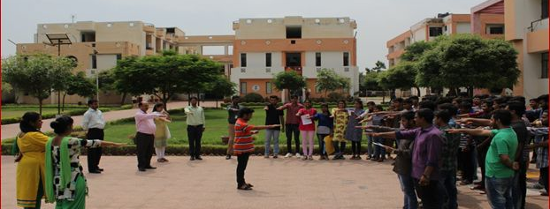
TESLA 9/17
The oath, we all moved toward college gate with slogan, then coordinator, faculty member and students spread the awareness among people that cleanliness is next to Godliness. Poster with slogan made by student coordinator are-
·
Ek Kadam Swachhata ki ore
Use dustibin and live green
Swachhata apanao desh ko vikash ke path par lao
Cleanliness is a stepping stone to success
Keep calm and clean Jaipur
We have observed that after being educated people throw the litter in their surrounding without understanding the harms of unhygienic conditions. We support this cause for better environment and always participate in the activities related cleanliness in our city. The location of the project is nearby areas of our JECRC college and tonk Roads which leading to our college. The main actions taken are Interviews with people living in slum areas, their views about cleanliness, the conditions they live in, contribution of civic bodies and people themselves to keep the area clean.

Slide 20
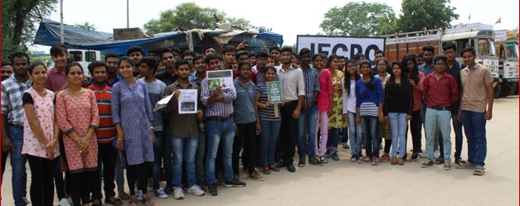
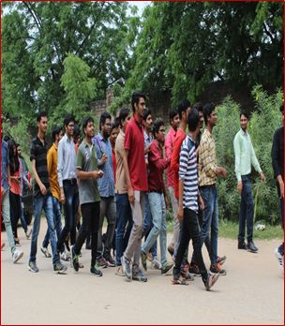
TESLA 9/17

Slide 21
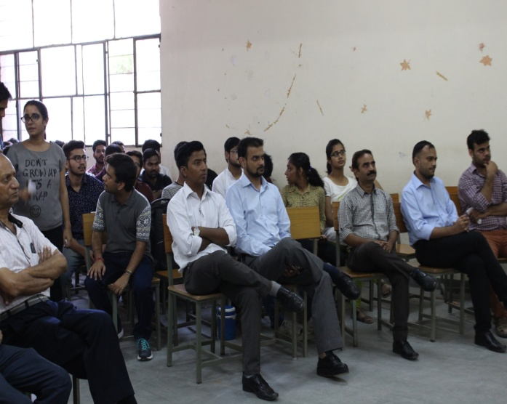
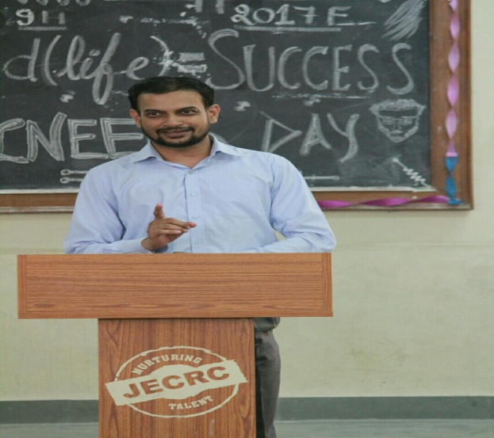
TESLA 9/17
ENGINEERS DAY CELEBRATION
“Engineering is not merely knowing and being knowledgeable; engineering is not merely analysis; engineering is not merely the possession of the capacity to get elegant solutions to non-existent engineering problems; engineering is practicing the art of the organized forcing of technological change”
In remembrance of Sir Mokshagundam Vishweshwarayya , the most outstanding Engineer of all times, the engineering fraternity of India celebrates “Engineer Day “every year on 15th September. It was this day 154 years ago that this great contributor to growth and engineering was born. Engineers operate at the interface between science and society. To identify the great works done by our hard working engineers every year, 15th September is celebrated as “Engineer’s Day” marking the birthday of Sir Mokshagundam Vishweshwarayya, recognizing his contributions in the field of hydro power energy in India.
In JECRC Jaipur, we have celebrated an Engineer’s day by organizing the technical events for the students of Electrical Engineering. In all event altogether approximately 100 students have participated from Electrical department.

Slide 22
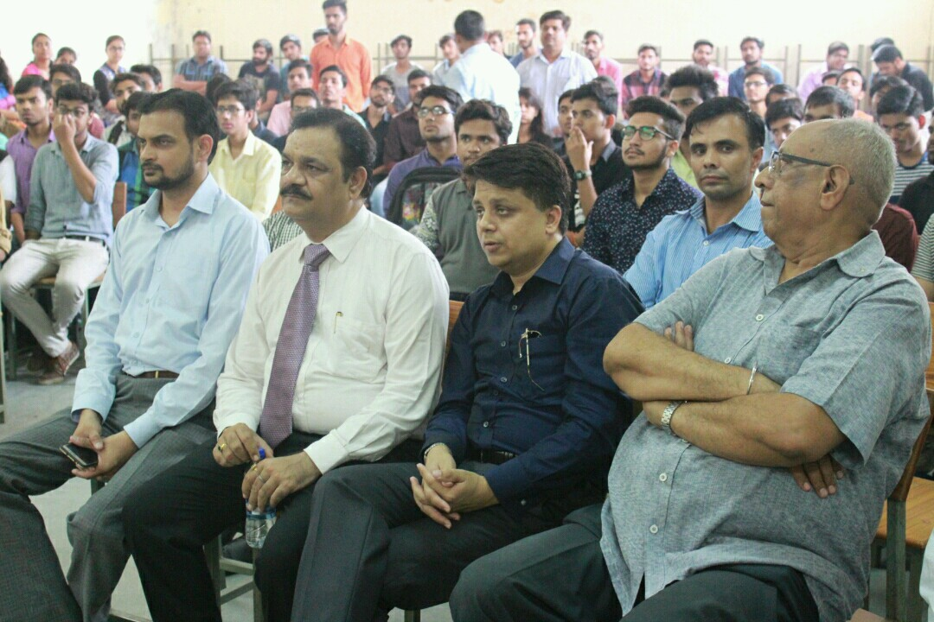
TESLA 9/17
As it is said “what you need to invent, is an imagination and a pile of junk”-An engineer fulfils this saying.
The function proceeded with the poems, mimicry, singing and a healthy interaction between the students and teachers. The highlight of the function was the extempore activity that filled the ambience with a breath of fresh air and engrossed everybody completely.
Respected Director sir, Principal sir and other management dignitaries of JECRC also encouraged the students with their presence in the event. The ceremony was concluded by the HoD sir with his inspiring words and filled the students with positive vibes.
It was a wonderful experience for students as well as staff. Every students as well as faculty was very cooperative. We are thankful to all faculty members and students for giving their valuable time and making this event successful.

Slide 23
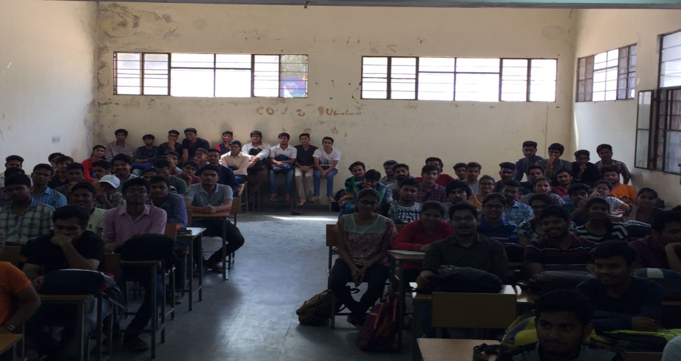
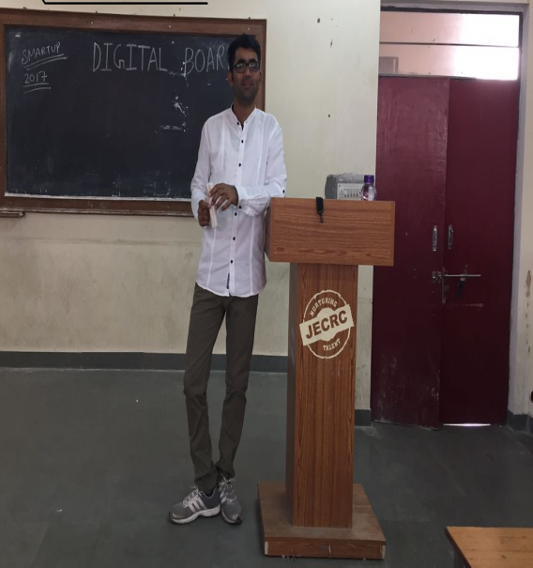
TELSA 9/17
Guest Lecture Session
An informative Guest Lecture was hosted by the department. The engineer in Indian Railway Mr. Mohan Chaudhary discussed the topics dealing with machines and provided relevant details regarding the stream. A long with this general discussion on generators and lenz’s law was carried out to enrich the knowledge of students.
The seminar had a gathering of students from second and third year of the department. The guest faculty also gave information on the future career prospects in engineering. He informed about several exams including GATE, IES and also provided guidance to crack these. He also expressed his deep concern on the ways to excel in goal a student is preparing to qualify. Moreover, he introduced smart ways of studying to enhance the output in the exams and various technical competition.

Slide 24
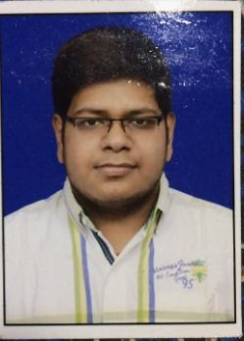

TESLA 9/17
ACHIEVEMENTS
Alkesh Srivastava(2nd year)- Started a game production venture on the Google play store of the very famous platform, Android. He created the game called, “ The TapBait” and launched it officially on 12th August, 2017. Within first week of the launch it reached 100+downloads. Today, the number of download are nearing 500 and the rating 4.9
Here is the link to the game:
https://play.google.com/store/apps/details?id=com.Alkeshproduction.TheTapBait&hl=en

Slide 25
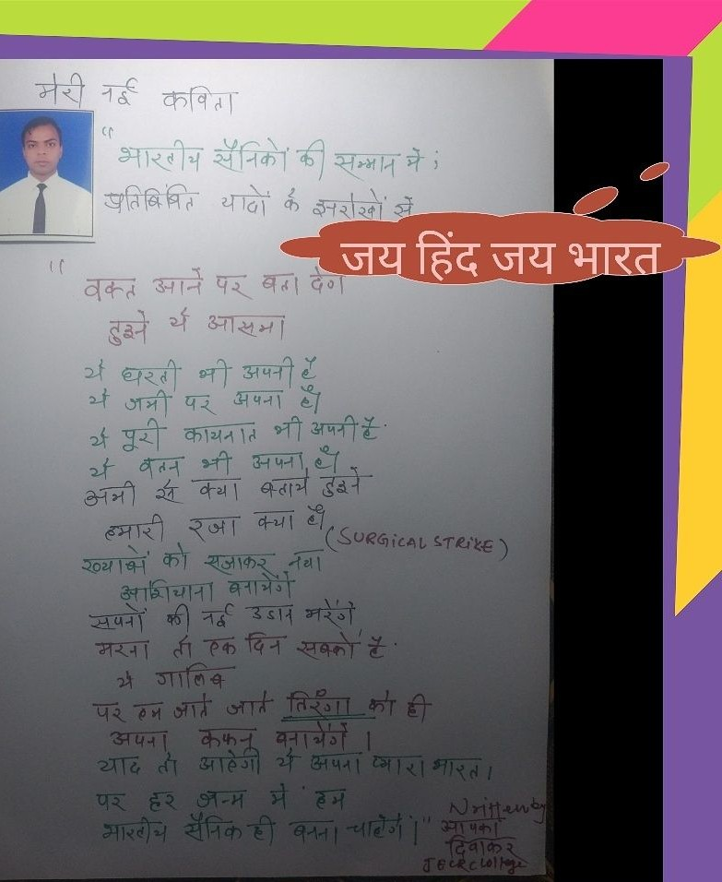
Abhishek Jain(4th year)- written a poetry dedicated to Indian Army and was published in the newspaper.
TESLA 9/17

Slide 26
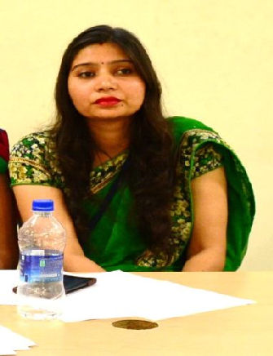
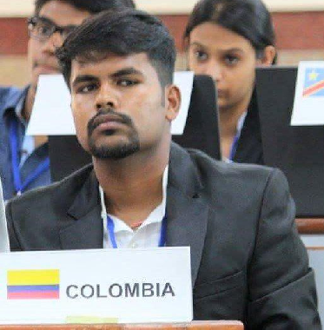
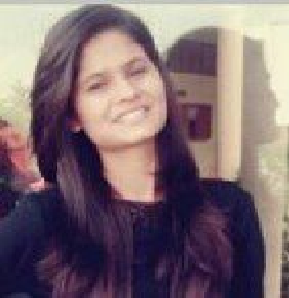
TESLA 9/17
EDITORIAL BOARD
Faculty Coordinator
Ms. Ravita Saraswat
Student Coordinators
Prakhar Joshi
Bharti Sharma

Slide 27
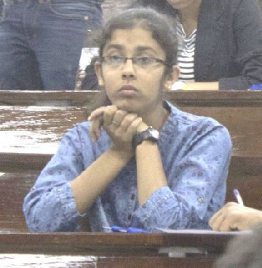
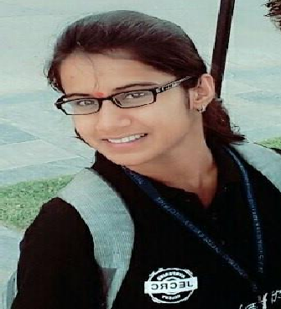
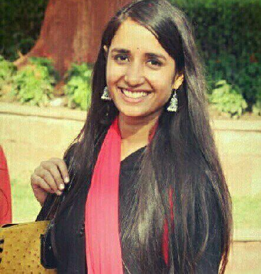
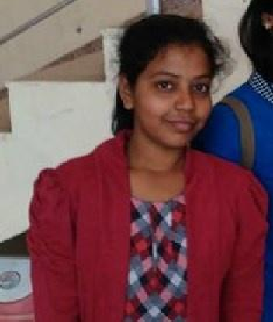
TESLA 9/17
Sakshi Sharma (3rd year)
Akanksha Sinha (3rd year)
Manu Sharma (3rd year)
Mridula Soni (3rd year)

Slide 28
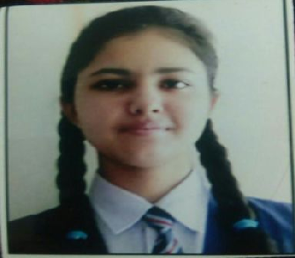
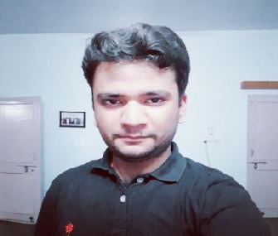

TESLA 9/17
Ujjwal Sharma (2nd year)
Shashwat Tripathi (2nd year)

